Slide 1
Natural Language Processing (NLP)
with Deep NLP
from Zero to Hero
FAHAD HUSSAIN
MCS, MSCS, DAE(CIT)
Computer Science Instructor of well known international Center
Also, Machine Learning and Deep learning Practitioner
For further assistance, code and slide https://fahadhussaincs.blogspot.com/
YouTube Channel: https://www.youtube.com/channel/UCapJpINJKHzflWwCQ8Kse2g/playlists

Slide 2
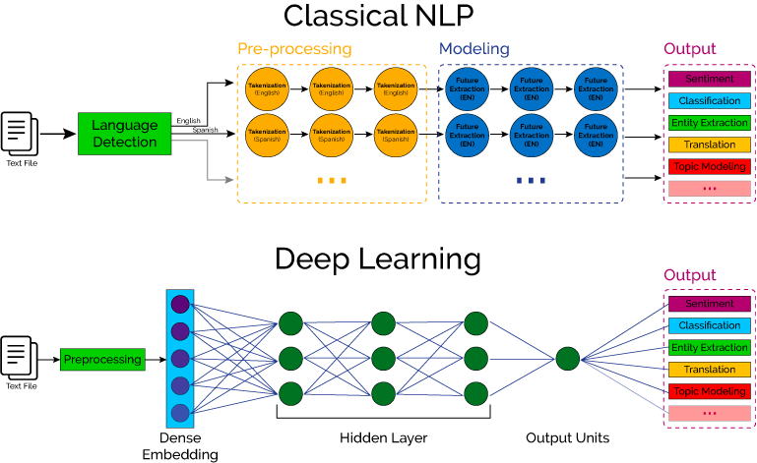

Slide 3
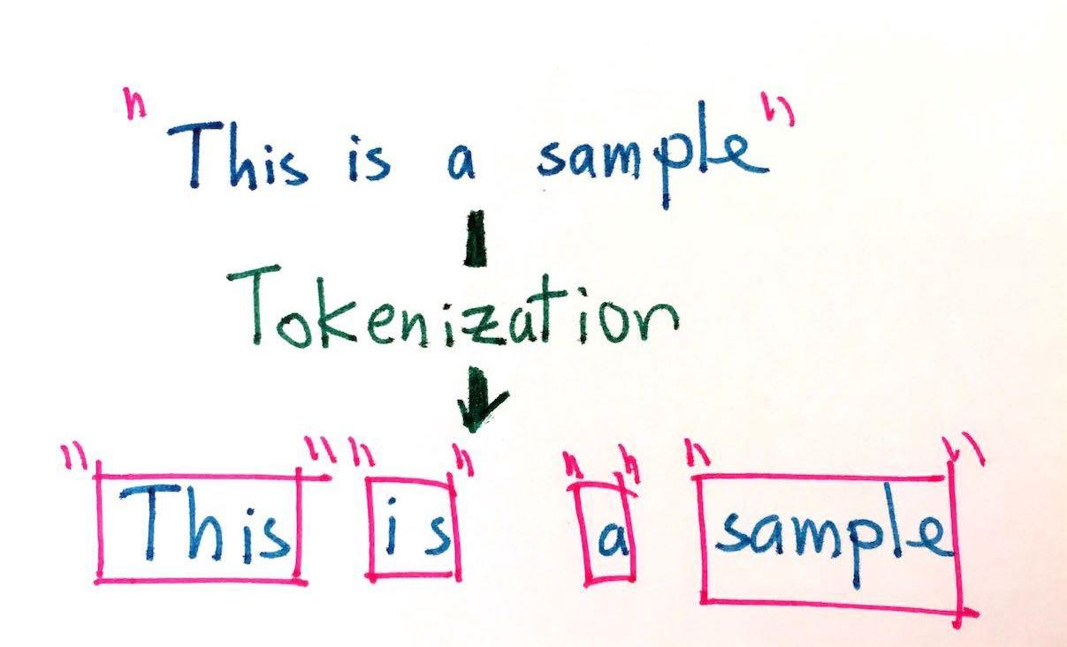
Tokenization
Tokenization is the process of replacing sensitive data with unique identification symbols that retain all the essential information about the data without compromising its security.
Fahad Hussain Tutorial
Fahad Hussain Tutorial
Fahad Hussain Tutorial
For further assistance, code and slide https://fahadhussaincs.blogspot.com/
YouTube Channel: https://www.youtube.com/channel/UCapJpINJKHzflWwCQ8Kse2g/playlists

Slide 4
Tokenization
There are many library / framework for NLP problem solution
1. Natural Language Toolkit (NLTK)
2. TextBlob
3. CoreNLP
4. Gensim
5. spaCy
6. polyglot
7. scikit–learn
8. Pattern
Fahad Hussain Tutorial
Fahad Hussain Tutorial
Fahad Hussain Tutorial
So lets' move to COLAB for practical work...
For further assistance, code and slide https://fahadhussaincs.blogspot.com/
YouTube Channel: https://www.youtube.com/channel/UCapJpINJKHzflWwCQ8Kse2g/playlists

